Slide 1
AUTOMATIC NUMBER PLATE RECOGNITION(ANPR)
Mentor: Sangeeth Group 28:
Kasthuri Vyshnavi
Sujith S Maity
Tania Yadav
Aditi Das

Slide 2
INTRODUCTION
Automatic Number Plate Recognition (ANPR) is a technology that uses optical character recognition on images of vehicle registration plates to read the vehicle’s registration number. An automatic license plate recognition system applies different image processing techniques to quickly and automatically identify vehicles in images or real-time video of one or multiple cameras.

Slide 3
Problem Statement
Automatic Number Plate Recognition (ANPR) implementation involves following steps:
1) Object Detection and creating bounding boxes.
2)Optical Character Recognition

Slide 4
Methodology
Object Detection and Creating Bounding boxes
Model evaluation on test dataset
Input( Dataset Images)
Spilt the dataset into train and test
Output
(Extracted text from number plate)
Deployment(Flask API)
OCR (Optical Character Recognition)

Slide 5
Object Detection
Object detection is a computer technology related to computer vision and image processing that deals with detecting instances of semantic objects of a certain class (such as humans, buildings, or cars) in digital images and videos.
We have used YOLO(YOU ONLY LIVE ONCE) Model for Object Detection. The key feature of YOLO is its single-stage detection approach, which is designed to detect objects in real time and with high accuracy.

Slide 6
Model Comparison In object detection
Model Name | Accuracy | Performance
InseceptionResNetV2 | 90.84% | Precision Low /Slow Process speed
YOLO-V5 | 93.7% | Precision High/Fast Process speed
YOLO-V8 | 95.6% | Precision High/Fast Process speed
We have a tried different models like yolov5,yolov8n of yolo to get accurate results.

Slide 7
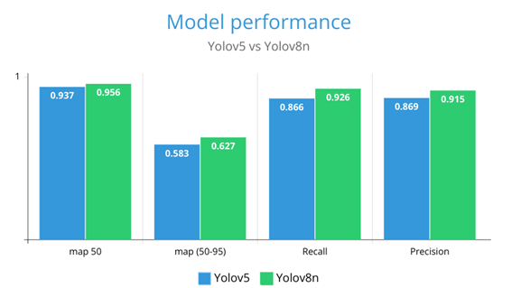
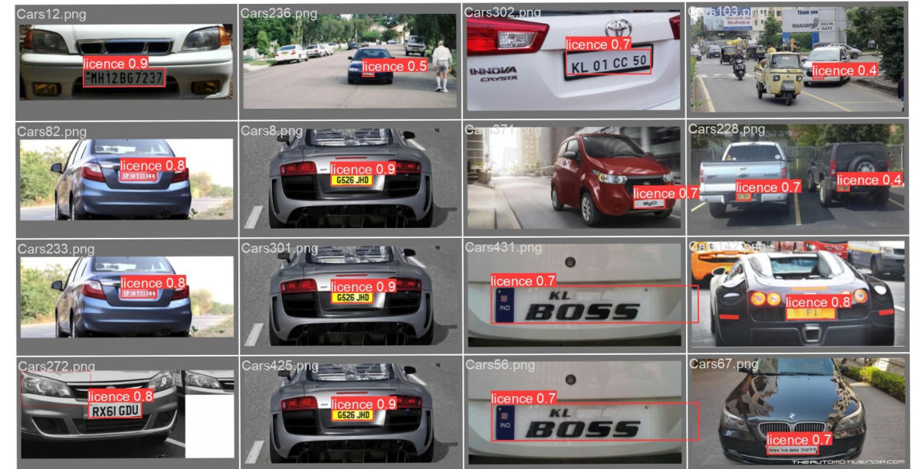
Model comparison and Results

Slide 8
Optical Character Recognition
OCR is often used to extract text information from images or regions of interest indentified by the objectdetection model.For OCR we have tried different types of OCR:
Pytessract OCR
Easy OCR

Slide 9
PYTESSRACT OCR
Python-tesseract is a wrapper for Google's tessract OCR Engine. In Tesseract OCR, the options --oem and --psm are used to specify the OCR Engine Mode (OEM) and Page Segmentation Mode (PSM), respectively.
In Pytessract we tried different psm(Page segmentation modes) and oem 3 as OCR engine mode.
1)PSM 6-Assume a single uniform block of text.
2)PSM 8-Treat the image as a single word.
3)PSM 11-Sparse text. Find as much text as possible in no particular order.
4)oem 3-Corresponds to the default mode, which uses both the Legacy Tesseract OCR engine and the LSTM-based OCR engine.

Slide 10
EASY OCR
Easyocr is a Python library for Optical Character Recognition (OCR) that aims to make text extraction from images easy and accessible.
It In-built uses CRAFT and CRNN.

Slide 11
Pros and cons
So based on pros and cons we have selected the pytessaract for OCR and got more accuracy comapre to Easy OCR.
Type | Pytessract | Easyocr
Ease of Use | Complex | Simple
Recognition Accuracy | Gives high Accuracy | Gives low accuracy
Language support | It support more than 100 languages. | EasyOCR supports a wide range of languages, including commonly used languages such as English, Spanish, Chinese, and French, as well as several less common languages.

Slide 12
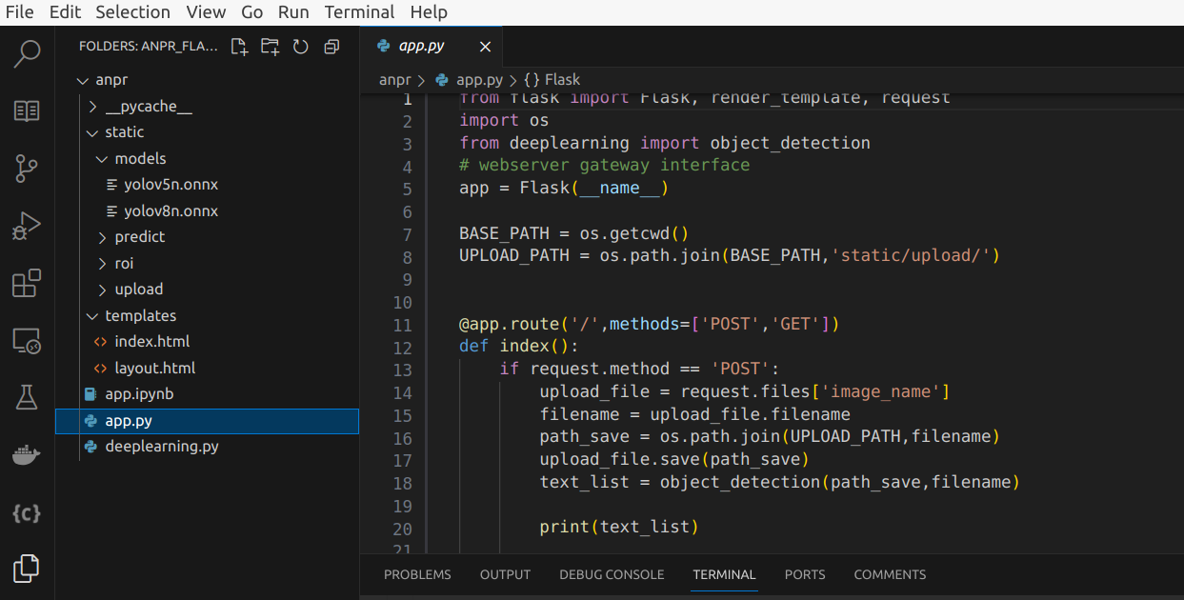
Deployment
We have deployed our model using FLASK API as backend.
For Frontend we used html .
We also exposed our API using ngrok.
It enables developers to expose a local development server to the Internet with minimal effort.

Slide 13
Learnings
Learning in depth about how object detection and image classifications work.
Idea to work on YOLO model with different versions.
Get to know about different types of OCR techniques like pytessract,EasyOCR.
Time management.

Slide 14
Challenges
1)Optical Character recognition is most challenging part for us to get accurate text extracted from the detected number plate.
2)Selecting which model is better for object detection.

Slide 15
APPLICTAIONS
Car Park management and access control
Hotels and commercial
Shopping centres
Golf clubs
Petrol station drive-offs
Hospitals

Slide 16
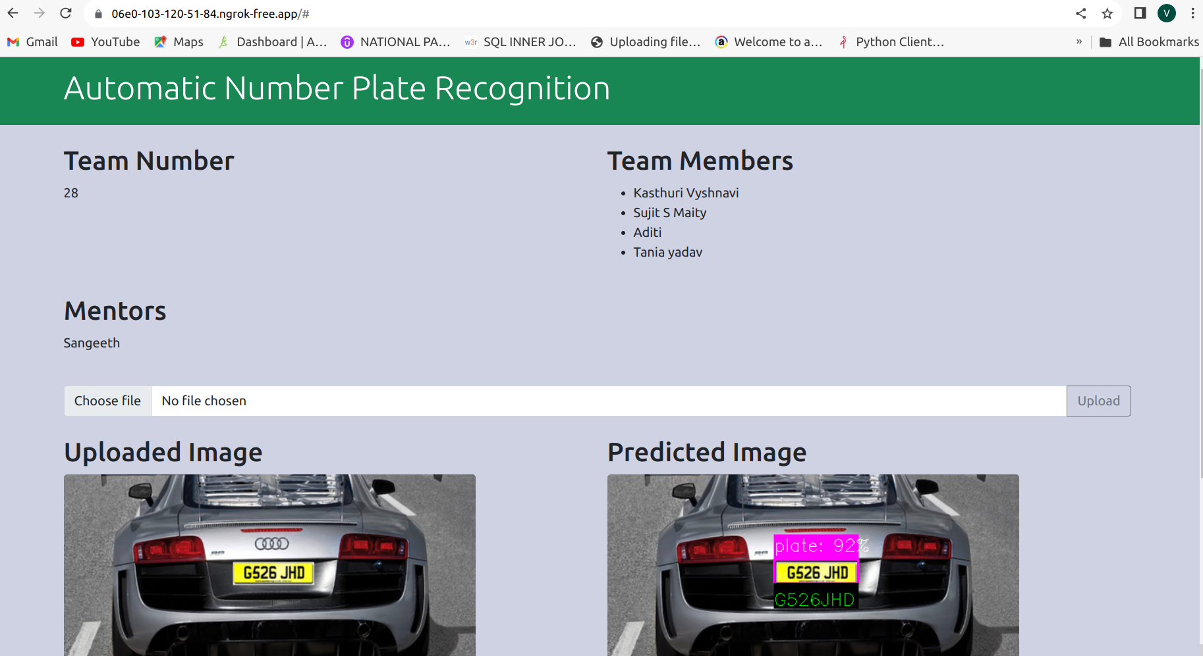
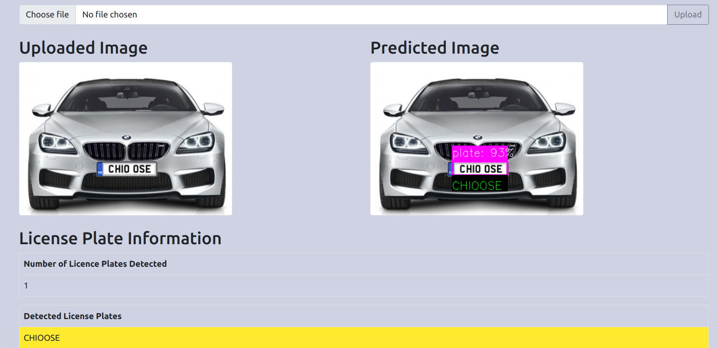
OUTPUT

Slide 17
THANK YOU

